Slide 1
Agentic AI NPA Management

Slide 2
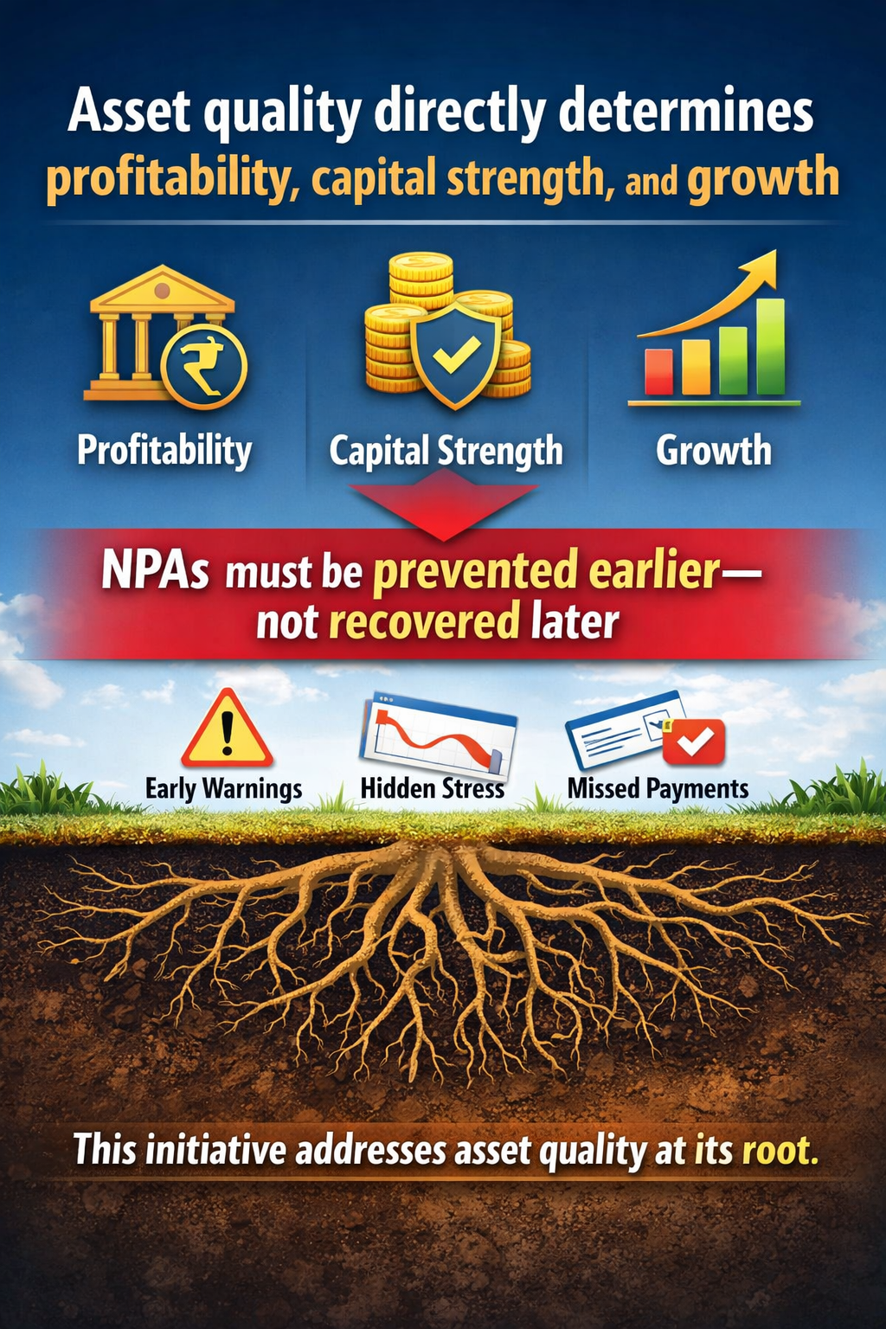
Strategic Priority: Asset Quality
Asset quality directly determines profitability, capital strength, and growth
NPAs must be prevented earlier—not recovered later
This initiative addresses asset quality at its root
Notes:
Open with the strategic importance of asset quality. Emphasize that NPAs are not an operational issue but a profitability and capital issue that directly impacts growth.

Slide 3
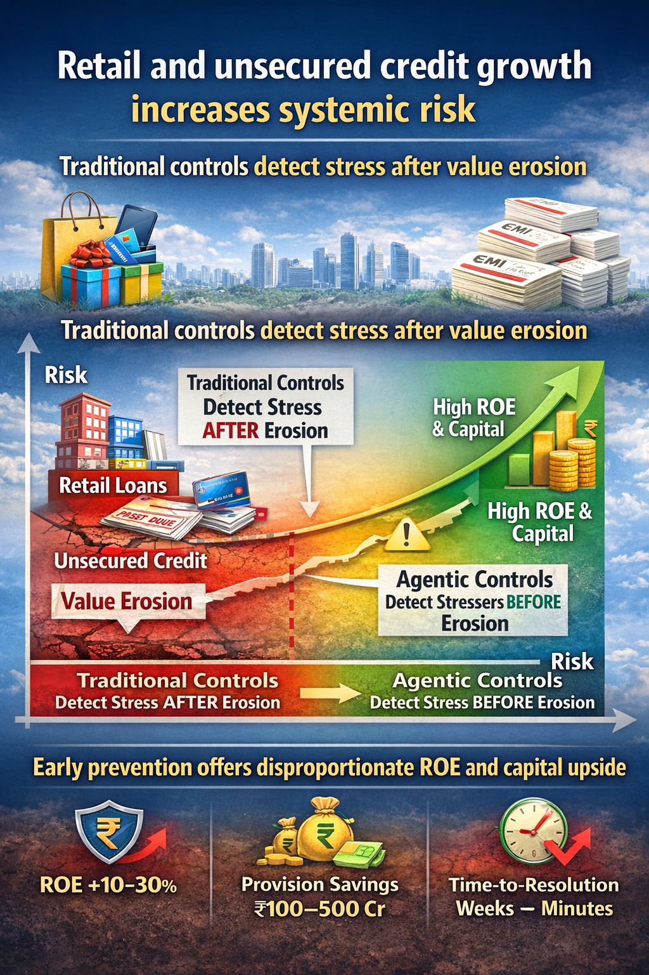
Why Now
Retail and unsecured credit growth increases systemic risk
Traditional controls detect stress after value erosion
Early prevention offers disproportionate ROE and capital upside
Notes:
Explain why timing matters now: retail and unsecured credit expansion increases latent risk. Highlight that early detection creates outsized ROE benefits.

Slide 4
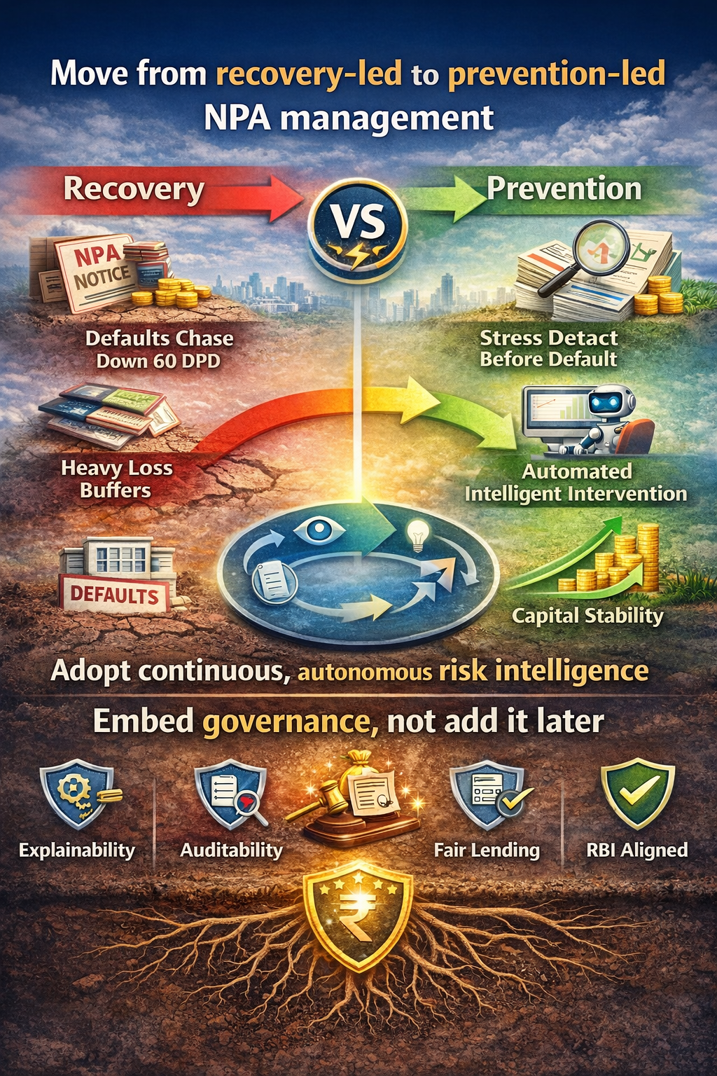
The Strategic Shift
Move from recovery-led to prevention-led NPA management
Adopt continuous, autonomous risk intelligence
Embed governance, not add it later
Notes:
Position this as a mindset shift, not a technology upgrade. Stress prevention over recovery and governance-by-design.

Slide 5
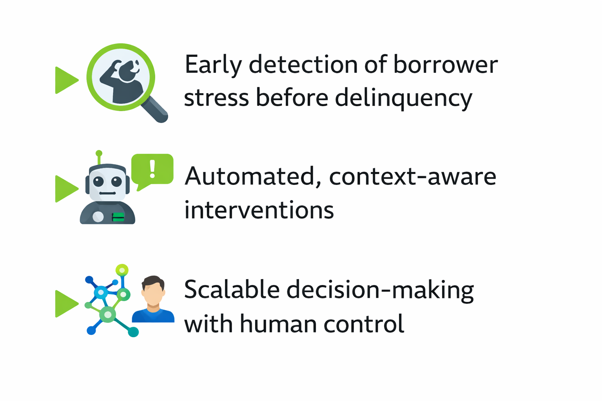
What Agentic AI Changes
Notes:
Clarify that Agentic AI works like a digital risk officer—observing behavior continuously and intervening before delinquency.

Slide 6
Business Impact (12–18 Months)
60–120 bps reduction in GNPA
30–50% reduction in credit cost
Improved ROE through capital release
Better customer trust and retention
Notes:
Pause on this slide. Quantify impact in CEO language: bps improvement translates directly to capital release and growth headroom.

Slide 7
Risk, Governance & Regulatory Comfort
Human-in-the-loop for material decisions
Explainable AI with full audit trail
Aligned to RBI supervisory expectations
Ethical and bias-aware controls
Notes:
Proactively address regulatory comfort. Emphasize human oversight, explainability, and RBI-aligned controls.

Slide 8
Execution Approach
Phase 1: Shadow mode and validation
Phase 2: Assisted decisioning
Phase 3: Controlled autonomy
No disruption to existing operations
Notes:
Reassure execution safety. Highlight phased rollout with shadow mode to avoid operational or regulatory risk.

Slide 9
Market Fit — Agentic AI for NPA Prevention
Who It’s For
Banks & NBFCs with large retail and unsecured portfolios
Decision owners: CRO, COO, Chief Credit Officer
Economic sponsors: CEO, Board Risk Committee
Why the Market Pull Is Strong (Now)
Retail credit growth is outpacing risk controls
NPAs erode capital, ROE, and regulatory confidence
Boards demand early visibility — not post-fact explanations

Slide 10
Business Benefits
Reduced GNPA/NNPA
Faster response
Improved CX
Better capital efficiency

Slide 11
When Credit Failures Are “Sudden” Inspired by Bad Billionaires series
What History Shows (Across Major Financial Failures)
Stress signals appeared months or years before default
Risks were visible but fragmented across systems
Confidence and growth narratives overrode early warning signs
Why Traditional Risk Controls Fall Short
Threshold-based alerts trigger after value erosion
Reviews are periodic, not continuous
Human judgment is vulnerable to bias under growth pressure

Slide 12
Agentic AI Enables Prevention — Without Sacrificing Governance
What Agentic AI Changes
Continuously connects behavioral, financial, and contextual signals
Detects stress trajectories, not isolated events
Triggers early, proportionate interventions before delinquency
Governance & Regulatory Comfort (Non-Negotiable)
Human-in-the-loop for all material decisions
Explainable outputs with full audit trail
Controlled autonomy aligned to RBI expectations
Business Impact (12–18 Months)
60–120 bps GNPA reduction
30–50% lower credit costs
Improved ROE via capital release
Higher customer trust through early support

Slide 13
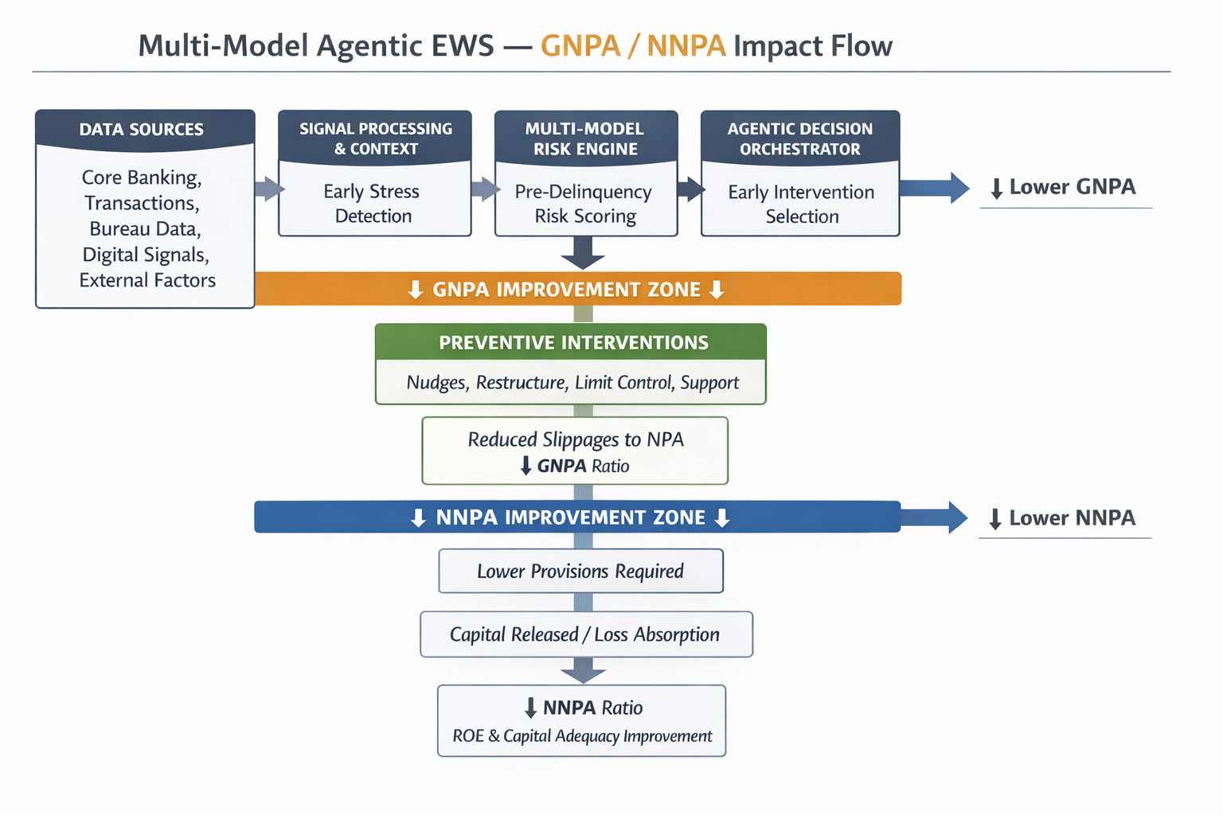
Architecture of Agentic AI

Slide 14
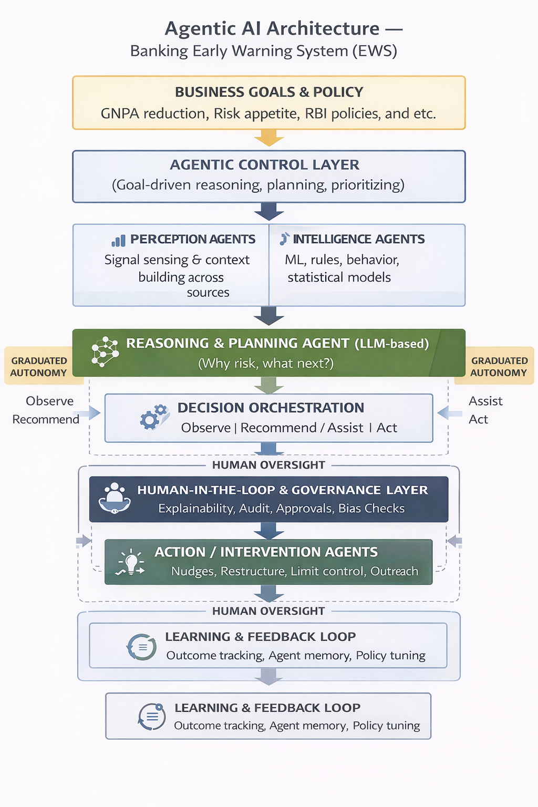
Continued

Slide 15
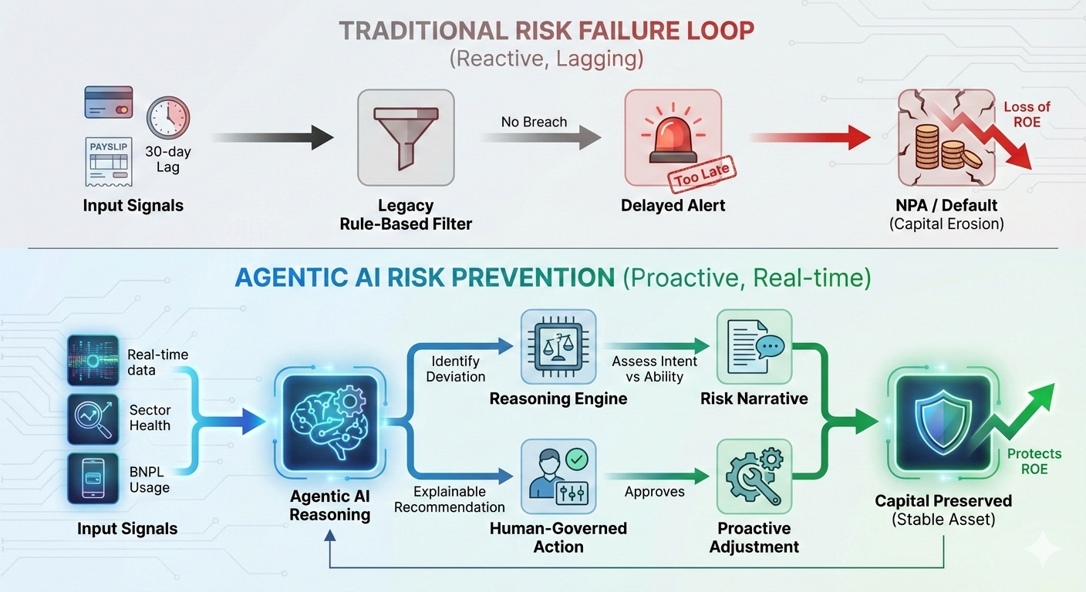
Detailed use case

Slide 16
Conclusion → Protect Asset Quality Before It Becomes a Capital Problem
Key Take Aways
GNPA reflects preventable stress, not inevitable loss
NNPA reflects capital at risk after damage is done
Most value is destroyed between early stress and delinquency
Why This Matters Strategically
Every basis-point reduction in GNPA:
Lowers provisioning pressure
Protects capital ratios
Improves ROE
Prevention delivers outsized returns compared to recovery
What Agentic AI Enables
Continuous, early detection of borrower stress
Timely, proportionate interventions before delinquency
Human-governed, explainable decisions aligned to regulation

Slide 17
Thank you
Closing Thought
Asset quality is not protected at the point of recovery — it is protected at the point of early recognition.
What This Initiative Represents
A shift from reactive NPA management to preventive asset quality control
A governance-first use of Agentic AI, aligned with regulatory expectations
A measurable path to:
Lower GNPA
Improved NNPA
Stronger ROE and capital resilience

